Slide 1


ABAP on Hana s/4 Hana Training
Day 20
contact@anubhavtrainings.com

Slide 2

Agenda – Day 20
S/4HANA End to End PoC of ALV IDA ( Integrated Data Access )
Implementing ALV

Slide 3

End to End ALV IDA ( Integrated Data Access )
Overview. ALV with IDA (SAP List Viewer with Integrated Data Access) helps tables that contain very large quantities of data to be displayed on the UI. ... It uses the in-memory database, such as SAP HANA, without having to switch to a new programming environment.

Slide 4
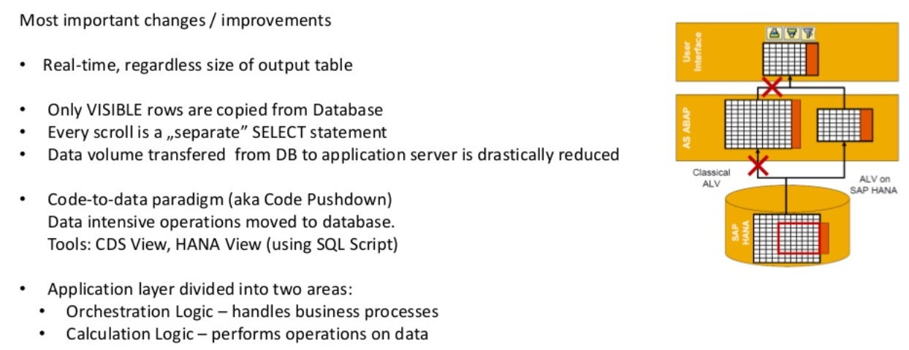
ALV with IDA Introduction

Slide 5
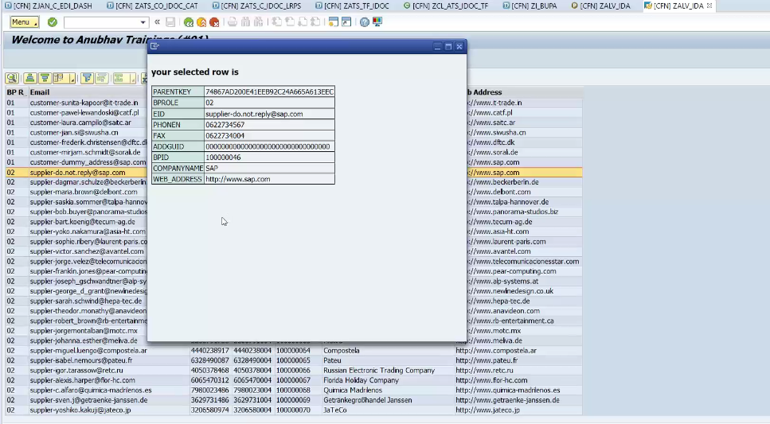
Implementing ALV IDA Integrated Data Access

Slide 6

Exercise
S/4HANA End to End PoC of ALV IDA Code

Slide 7

End of Day 20
Trainer: Anubhav Oberoy

Slide 8

Trainer: Anubhav Oberoy

Slide 9
THANK YOU
If you cannot do
great things, do small things in a great way.
Anubhav Oberoy
https://www.anubhavtrainings.com

Slide 10


We’re committed to empower you to be
Most Desirable Resource
through powerful training solutions.
We build the workforce of the future.
250+
Corporate Clients
30,000+
Learners Trained
25000+
Learners Placed
FREE WEBINARS
Sign up for free webinars with industry experts every fortnight!
Enroll Now!
Contact us today!
https://anubhavtrainings.com/

Slide 11




More from AnubhavTrainings.com

